Slide 1
Tuesday, September 6, 2016
Write In Your Agenda:
Write In Your Monitoring Log:
CW:
Finish Scientific Method flip book
Finish Convection Current lab packet.
Amazing Crust webquest.
HW:
Finish Amazing Crust webquest.
Response to Warm-Up:
What were the "lithospheric plates" during the convection currents lab and what did you notice about them?
You will need:
Pencil
Scientific Method Flipbook
Convection Current lab packet
To hand in last week’s monitoring log

Slide 2
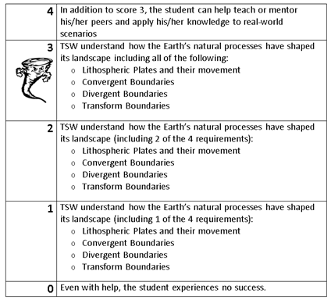
Learning Goal and Scale
TSW understand how the Earth’s natural processes have shaped its landscape (including Lithospheric Plates and their movement, Convergent, Divergent, and Transform boundary landforms).

